Slide 1
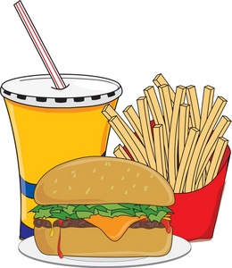
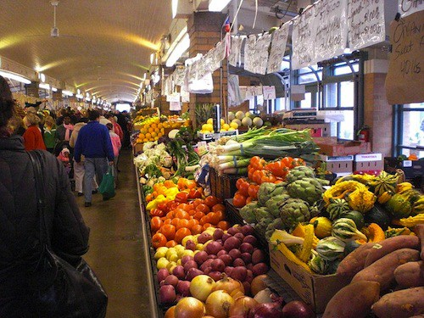
Food Deserts in Baltimore City
Michelle Seaberg
The Mount Washington School
May 1, 2016

Slide 2
What is a Food Desert?
In Baltimore City a food desert is defined as an area where:
The distance to a supermarket or supermarket alternative is more than ¼ mile
The median household income is at or below 185% of the Federal Poverty Level
Over 30% of households have no vehicle available
The average Healthy Food Availability Index (HFAI) score for all food stores is low
More than two dozen areas in Baltimore have been identified as food deserts, but this problem exists in cities all over the world. It has been estimated that 23.5 million people live in food deserts.

Slide 3
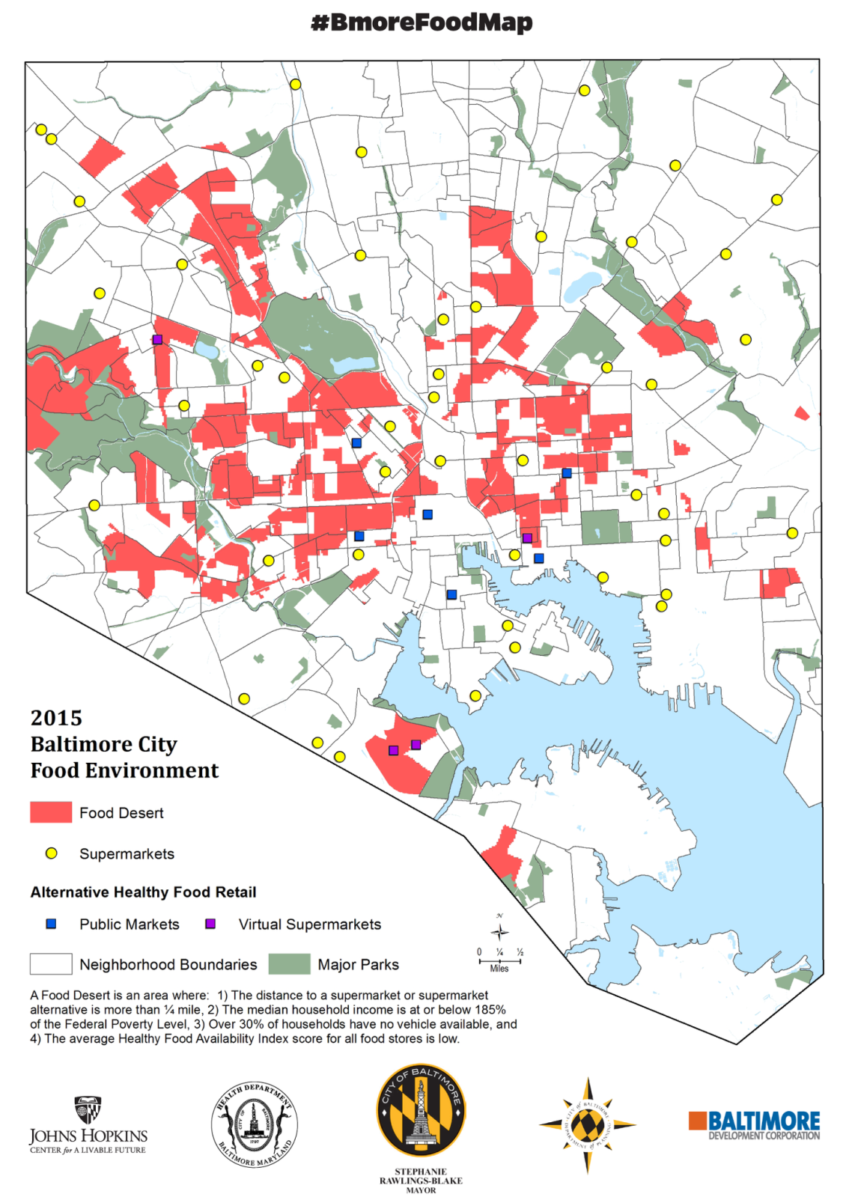
The Cause of Baltimore Food Deserts
Stores with healthy food do not want to build in areas with a lot of low income families because healthy, fresh food is usually more expensive and many people in such areas are unable to afford as much. These areas also often have more problems with violence and vandalism which raises costs for stores and makes them generally unappealing places for business.
Thus, the only food stores that get built in certain areas are cheap corner stores and fast food restaurants. This lack of nutritious food results in a food desert.

Slide 4
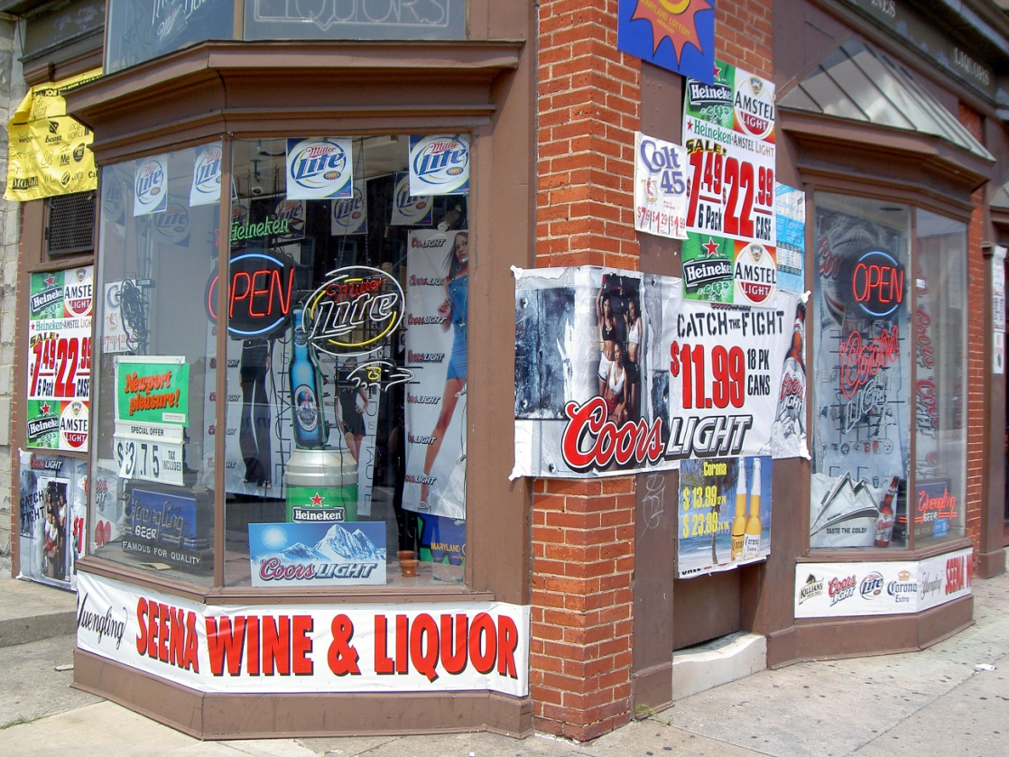
Prevalence in Baltimore
25% of Baltimore city residents live in a food desert, including 30% of children in Baltimore. It also disproportionately affects African Americans with 34% living in a food desert. These more than two dozen areas are scattered throughout Baltimore. They are filled with corner stores and fast food places that sell little or no fresh produce, but are crammed with junk food, snacks, and alcohol.

Slide 5
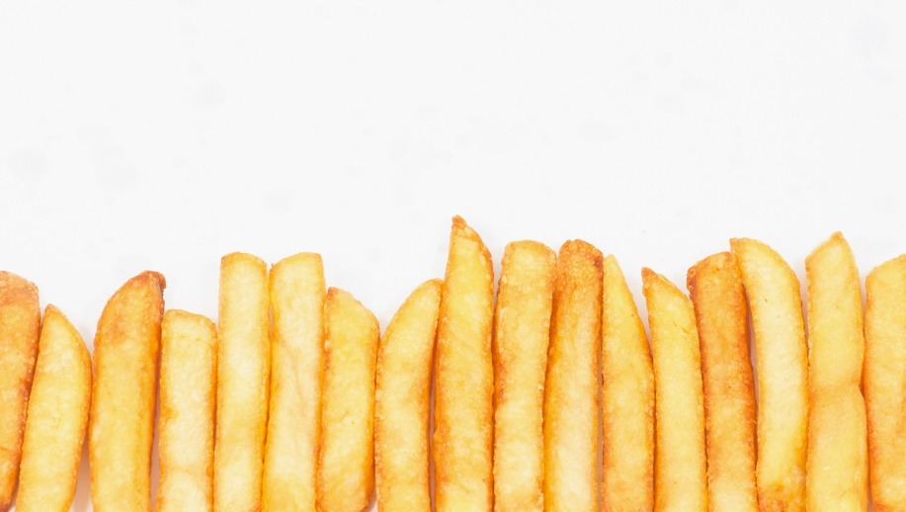
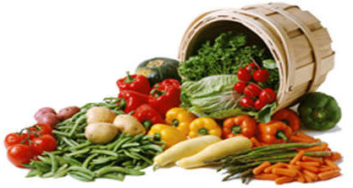
The Harm of Living in a Food Desert
Living without healthy food impacts children’s growth.
Children living a food desert do worse in school than their peers.
Living in a food desert increases your risk of cardiovascular disease, asthma, and hypertension and doubles your risk of death from diabetes.
All of these end up furthering the divide between races and socioeconomic classes in Baltimore.

Slide 6
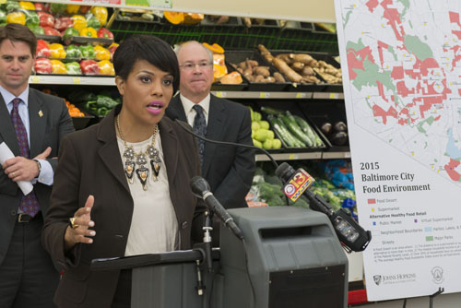
How this Problem is Being Solved
Some of the main efforts to eliminate food deserts are coming from the Baltimore City Government. The City Council approved a legislation to increase access to healthy food by providing tax cuts to urban farms, virtual supermarkets (an online shopping service with delivery), and developers who want to build grocery stores in food deserts. They also plan to make it easier to use food stamps (now known as SNAP) in local farmers markets.
There are also many private organizations trying to help fight this problem.
Baltimore City Mayor Stephanie Rawlings-Blake speaking at the Food Environment Map Report

Slide 7
Baltimore Orchard Project
The Baltimore Orchard works with local groups to plant and maintain orchards and gardens all over Baltimore.
They have planted more than 600 trees that provide communities with:
Fresh, free produce.
An easy way to improve the look of their neighborhood.
A way to strengthen community ties.
This not only provides healthy produce to low income communities, but also makes them look and feel cleaner and friendlier.
This attracts more people to live there and more businesses to open up, improving the overall economic status of the communities and making it more likely for healthy supermarkets to open up nearby.
Each tree on this map represents one orchards that the BOP has planted

Slide 8
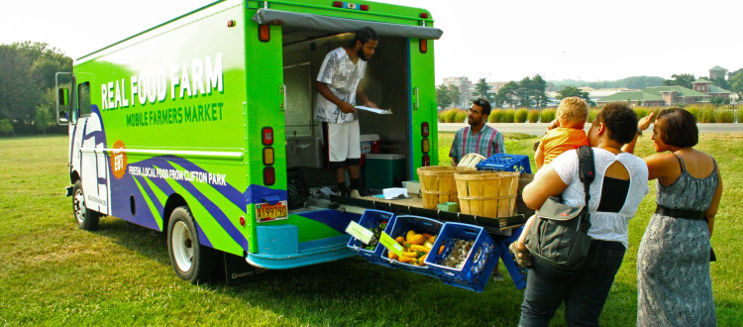
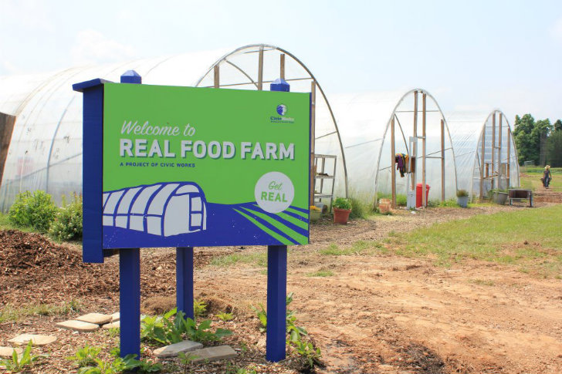
Real Food Farm
One of Real Food Farm’s Mobile Market trucks
Real Food Farm is an urban agricultural enterprise that grows and sells produce in and around northeast Baltimore.
They help the community by:
Growing fresh produce and selling it in low income areas in Baltimore, especially food deserts.
Educating children, through clubs and partnerships with schools, about sustainable farming and the Baltimore food deserts.
Real Food Farms is not only beginning to help solve the problem of food deserts by selling affordable, fresh produce, but they are also spreading awareness about this issue while giving kids valuable experiences and summer jobs.
The entrance to Real Food Farm

Slide 9
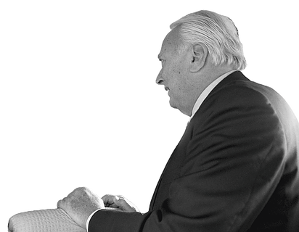
Lessons We Can Learn
Milton Wolf and the volunteers from La Benevolencija set an important example for us today. They teach us to never give up on your cause, no matter how hard it is. They exemplify the principle that as long as you know that what you are doing is right, you need to fight until you succeed.
These principles are important and are a reason we should fight to end food deserts. We know that there is a problem and that it is negatively affecting men, women, and children in Baltimore City. Therefore, it is our responsibility to try and end this inequality and not give up until we do.

Slide 10
Conclusion
Living in a lower socioeconomic status area should not deny you the right to food and health. And yet people living in food deserts are not able to get healthy, nutritious food. People deserve to have access to supermarkets and grocery stores no matter where they live. Furthermore, the disadvantages of people in food deserts distance them from the rest of Baltimore City, which only leads to a deeper divide between people of different income levels. This issue needs to be solved and we can take after the examples and principles of Milton Wolf and La Benevolencija to do so.

