Slide 1
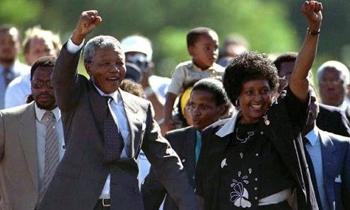
The Cold War - The impact on South Africa - 1989-1991
What were the political implications of the collapse of Communism for South Africa?
Explain how the SA economy was affected by the collapse of the Communism.
How did the collapse of Communism impact socially on South Africa?

Slide 2
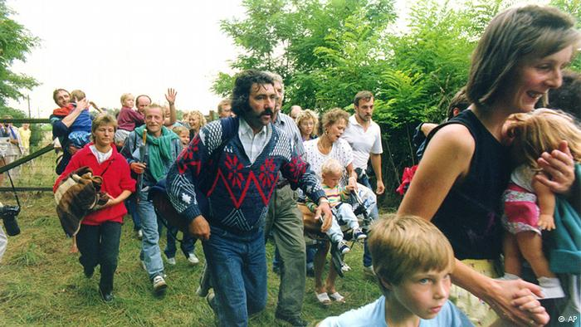
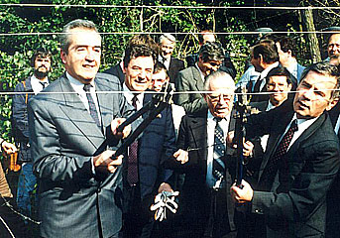
The Picnic That Changed European History Sopron, Hungary19 August1989
On October 4, 1990, Helmut Kohl announced that it was in Hungary where "the first stone was knocked out of the wall." The first holes appeared in the Iron Curtain following an August picnic in Sopron.

Slide 3
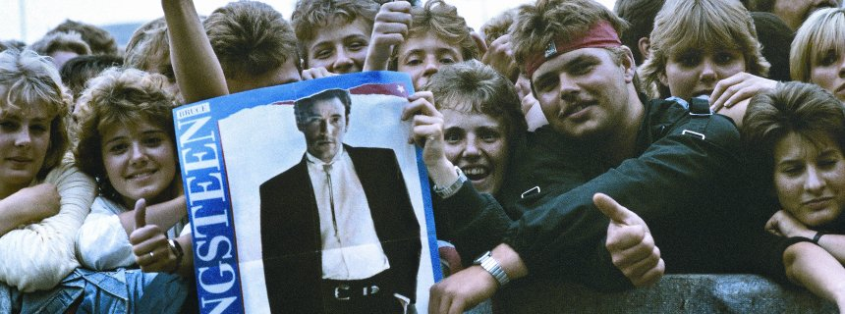
The Fall of the Berlin Wall
Chimes of Freedom
Born in the USA
"I'm not here for any government. I've come to play rock'n'roll for you in the hope that one day all the barriers will be torn down,"
Bruce Springsteen - 19 July 1988 - East Berlin

Slide 4
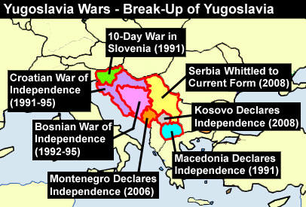
14th (extraordinary) Congress of the League of Communists of Yugoslavia was held from 20 to 22 January 1990, in the Belgrade Sava Centar. This event was one of the key moments for the beginning of the breakup of Yugoslavia.

Slide 5
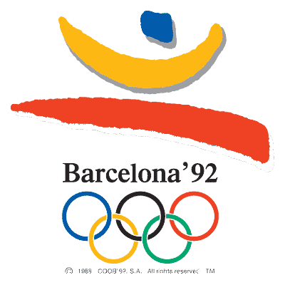
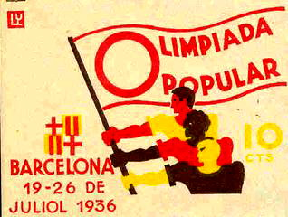
1992 the first post-Cold War Olympics took place in Barcelona. For the first time in many years the were not any boycotts from countries from the West or the East.
South Africa was allowed to compete in the Olympic Games for the first time since the 1960 Olympics.
As the Soviet Union had been dissolved in 1991, the Baltic nations of Estonia, Latvia and Lithuania sent their own teams for the first time since 1936. Cuba sent its team for the first time since 1980 and the unified Germany since 1936.
The separation of Socialist Federal Republic of Yugoslavia led to the Olympic debuts of Croatia, Slovenia and Bosnia and Herzegovina.

