Slide 1
The P.O.W.E.R Initiative
By Masilan Sundara
Promoting World Education through Reading

Slide 2
About Me and my Mission
My name is Masi Sundara, I am an 8th grader at Buist Academy for Advanced Studies. Over my summer vacation, I visited India to do a community service project. I had a particular goal in mind. It was to help schools in rural southern India promote reading and make it appealing to the elementary school students there. I hoped to encourage used English general reading books.

Slide 3
My School vs. Small Indian Village School
This is my school. I have access to an abundant amount of books. I learn about the world through reading. In contrast, this is what the classroom looks like in a small village in southern India. When I visited the schools in India, I hoped to teach the students about the world outside their village. I brought many books that I collected from donations and book drives here in the US that I thought could help me teach. I usually read 3 to 4 books a day. The use of general reading books really widened the students’ perspective of the world and they started forming their own opinions, ideas, and had questions. Something they had trouble with doing with state provided textbooks.

Slide 4
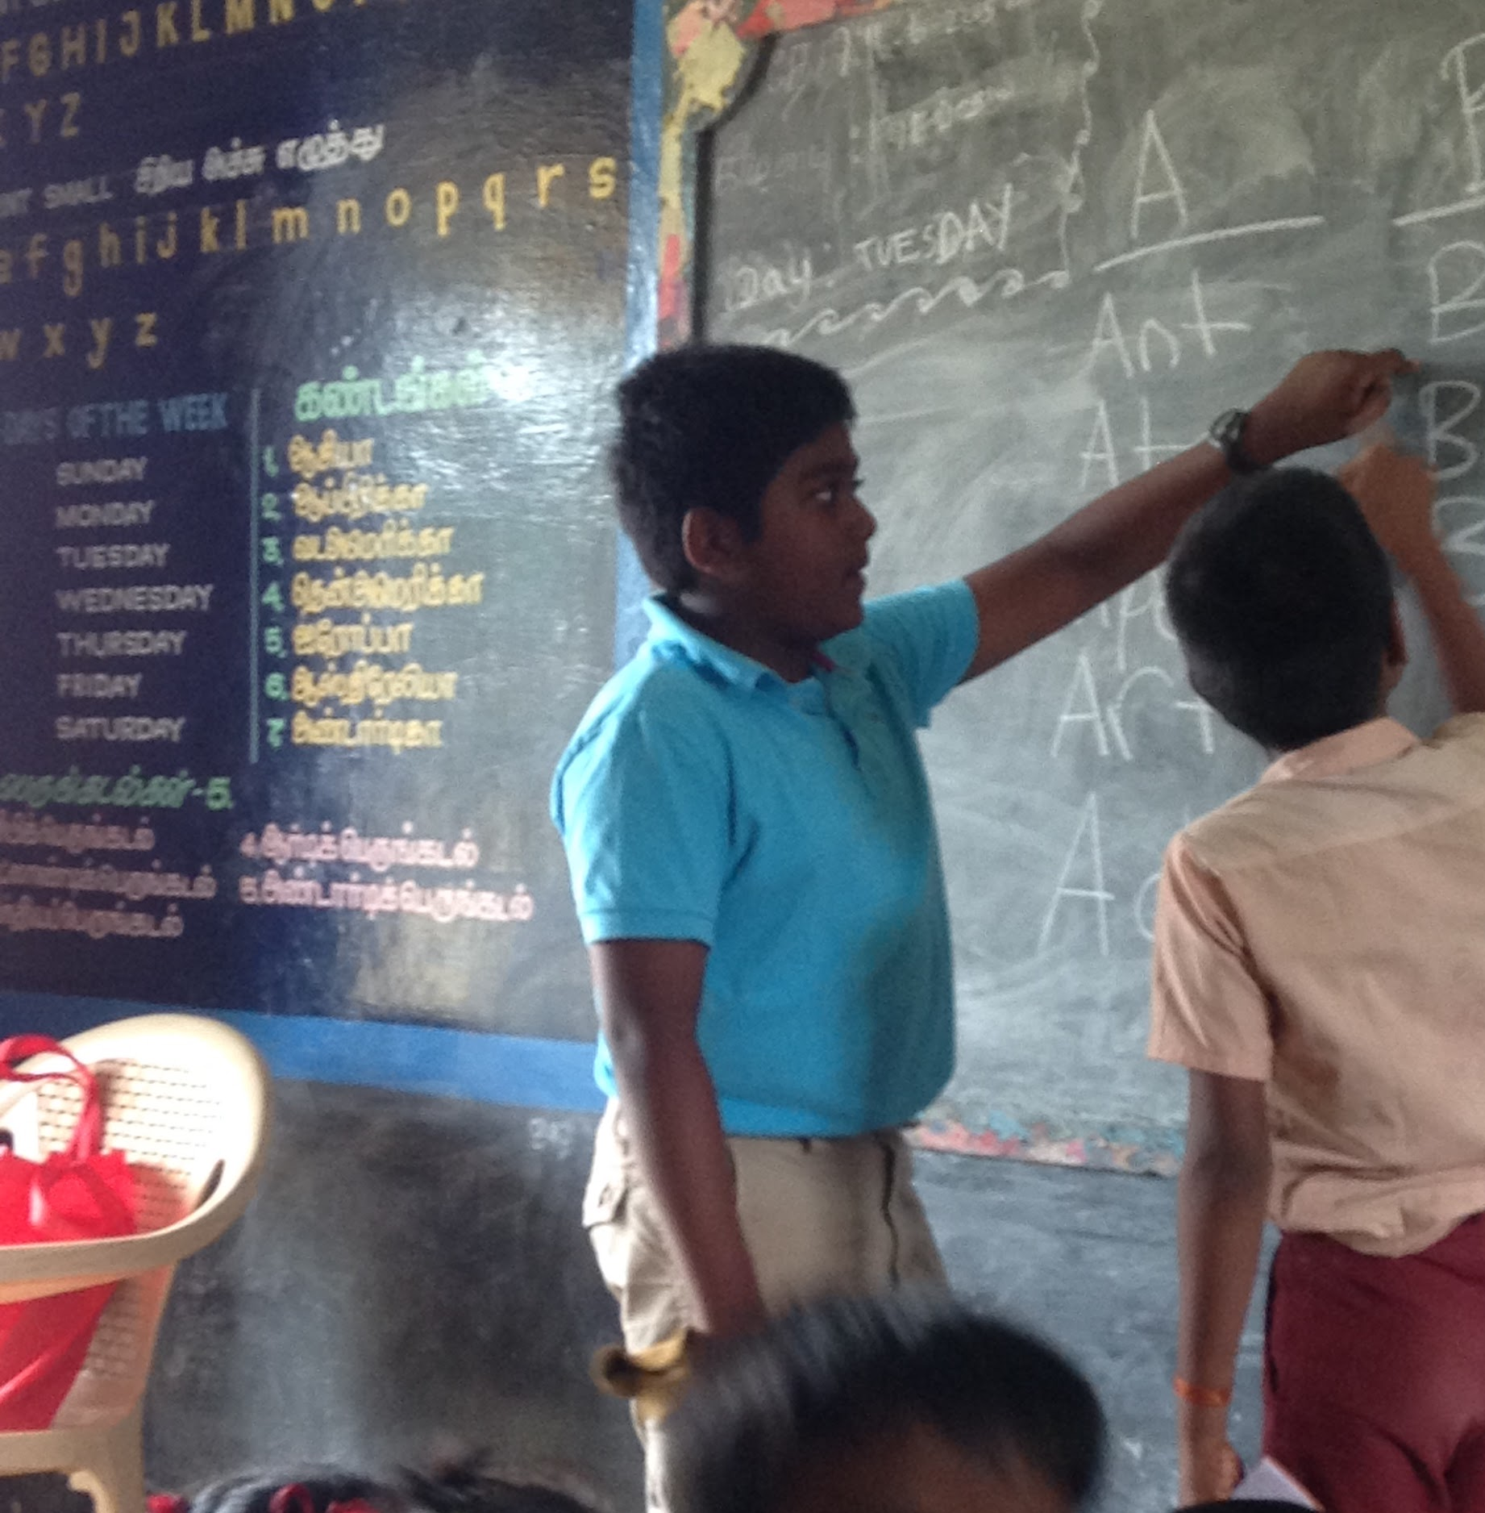
The Need
Students at both schools I taught at did not have enough resources to learn new things. I set out to change that. When I packed for my trip to India, I packed the essentials, and many, many books. I received these books from my school and local libraries. In total, I collected over 100 books that I later donated to 3 nearby schools. I plan on raising funds, awareness, and organizing book drives in the future, and I have already done so by speaking at my local rotary club and Kiwanis club of Charleston. Providing books was the probably the easiest part of my mission. The difficult part was reading the books, and organizing lesson plans for the students. It had to be appealing enough so that the students would become interested in learning about the world, and about what it’s like outside of their small village. I did this by reading the books I brought over from the US.
Notes:
Students at both schools I taught at did not have enough resources to learn new things. I set out to change that. When I packed for my trip to India, I packed the essentials, and many, many books. I received these books from my school and local libraries. In total, I collected over 100 books that I later donated to 3 nearby schools. I plan on raising funds, awareness, and organizing book drives in the future, and I have already done so by speaking at my local rotary club and Kiwanis club of Charleston. Providing books was the probably the easiest part of my mission. The difficult part was reading the books, and organizing lesson plans for the students. It had to be appealing enough so that the students would become interested in learning about the world, and about what it’s like outside of their small village. I did this by reading the books I brought over from the US.

Slide 5
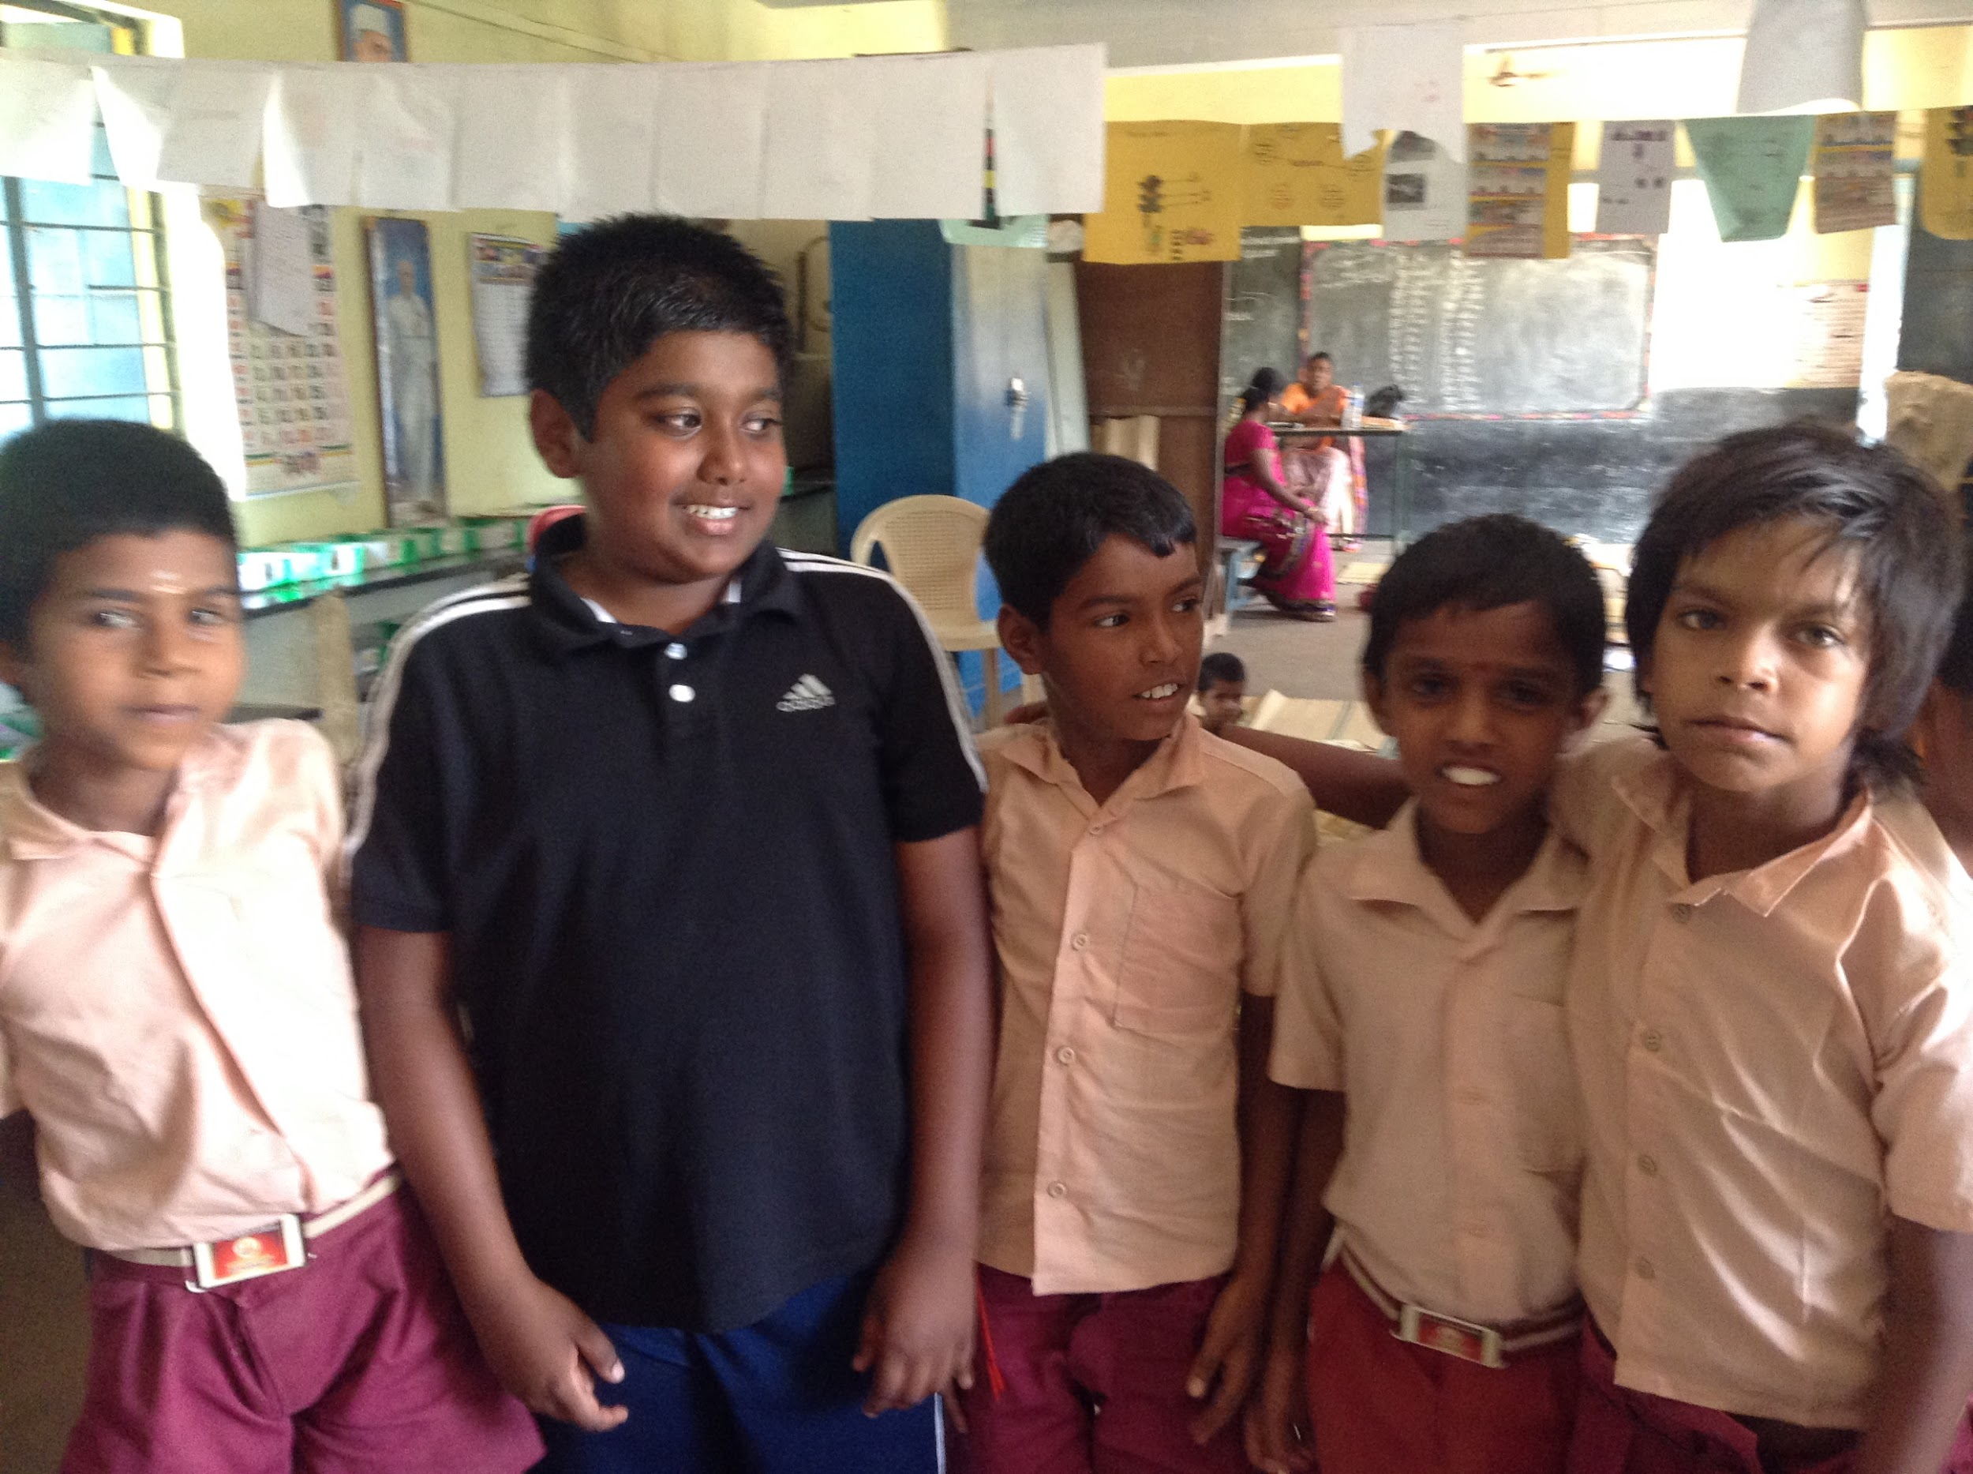
My Objective
I spent 4 weeks total in India. I went there in the summer, but the students still had school. I realized summer vacation is a privilege. Nevertheless, I taught at the school in the village of Karambakkudi for about 12 days. It was a smaller school physically, and it had less students compared to the one in Perukavalanthan, where I spent 13 days in.
Notes:
I spent 4 weeks total in India. I went there in the summer, but the students still had school. I realized summer vacation is a privilege. Nevertheless, I taught at the school in the village of Karambakkudi for about 12 days. It was a smaller school physically, and it had less students compared to the one in Perukavalanthan, where I spent 13 days in.

Slide 6
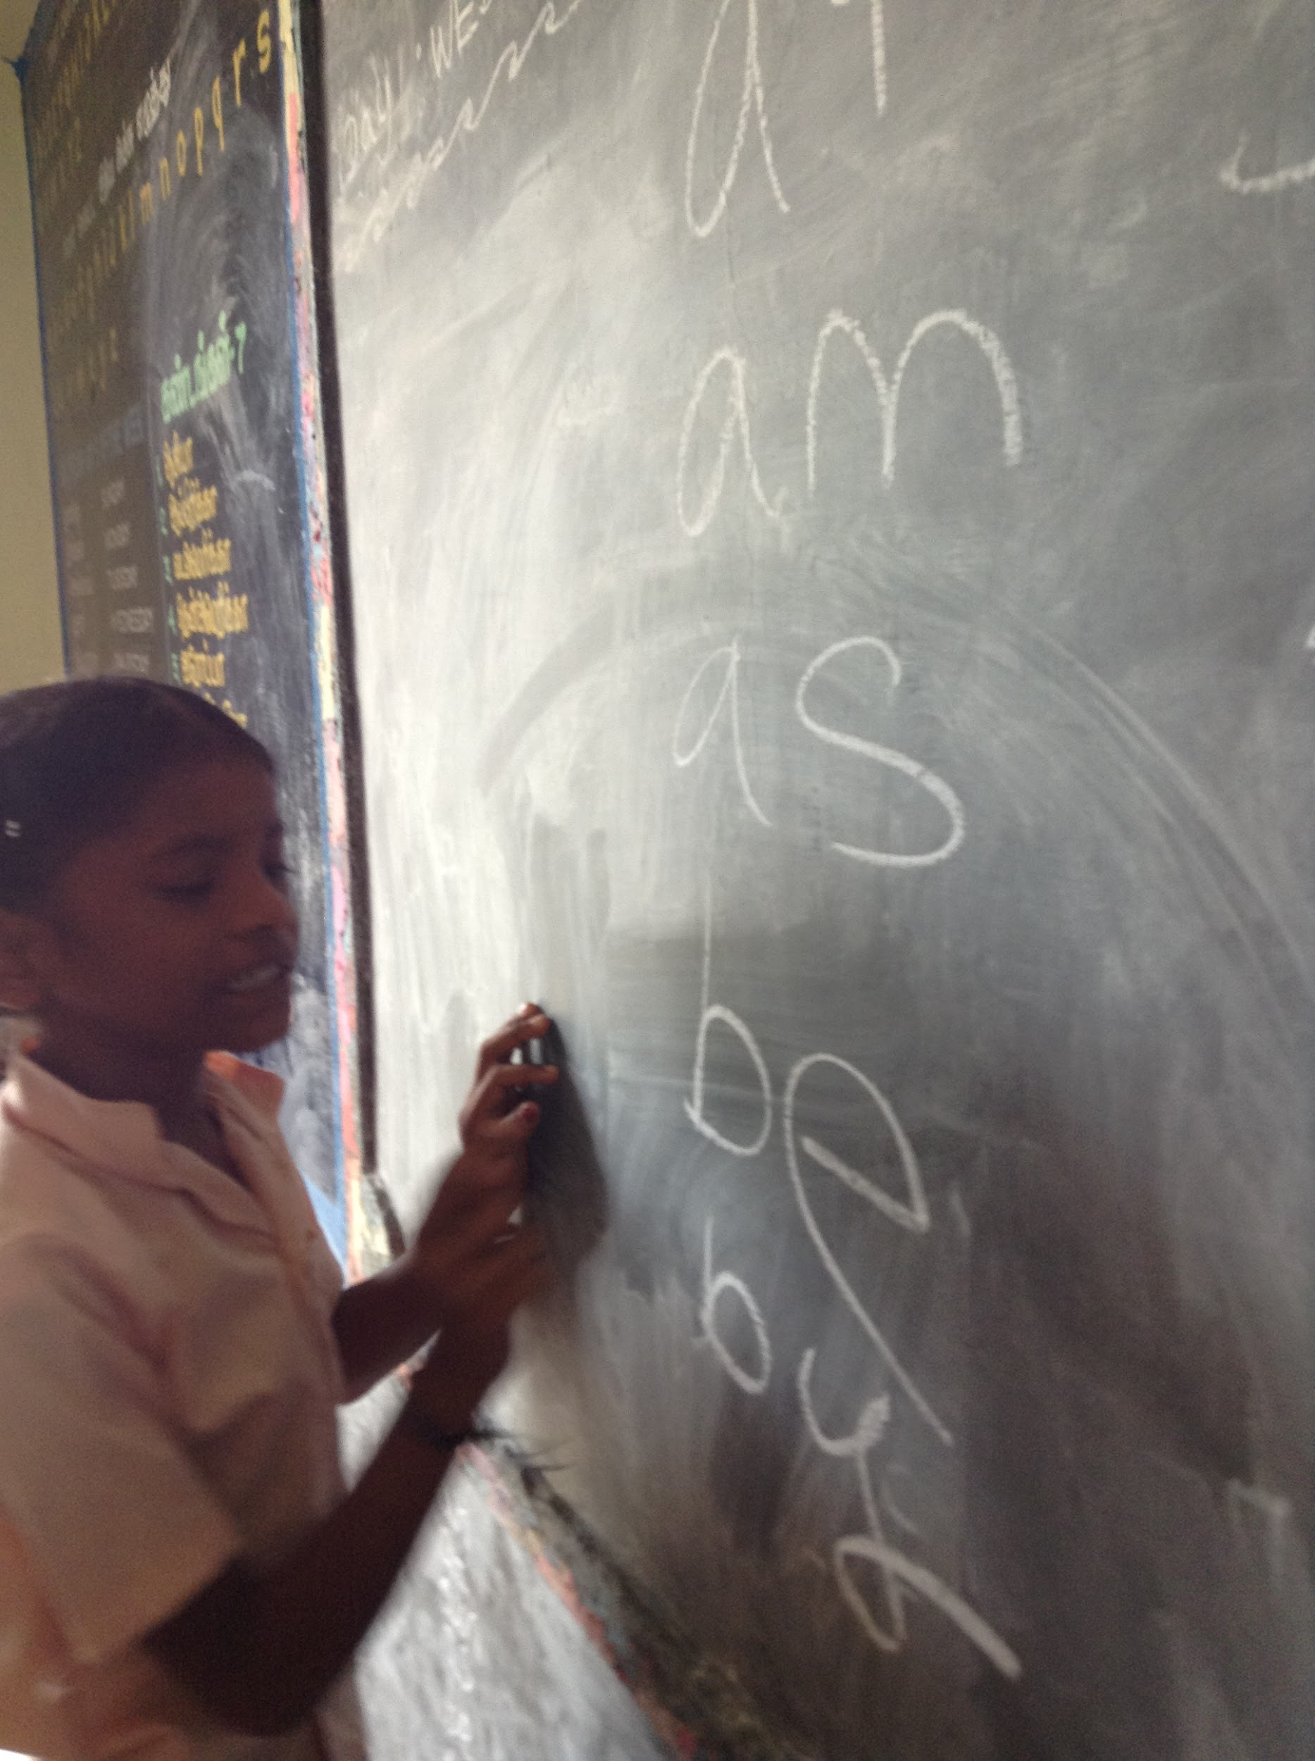
Why English?
English is a growing part of nations around the world. India is one of them. English is used to spell out common Tamil phrases. (Tamil is the common language spoken in rural southern India). I think English is going to be used more often in society than ever before and it is important for the future generation to be prepared.
Notes:
English is a growing part of nations around the world. India is one of them. English is used to spell out common Tamil phrases. (Tamil is the common language spoken in rural southern India). I think English is going to be used more often in society than ever before and it is important for the future generation to be prepared.

Slide 7
What do I hope to do Next?
I plan on organizing fundraisers, book drives, and awareness campaigns in order to raise money to build a library in over 30 schools in the local area. I have already spoken at my local rotary club and local Kiwanis Club about my mission in India.
Notes:
I plan on organizing fundraisers, book drives, and awareness campaigns in order to raise money to build a library in over 30 schools in the local area. I have already spoken at my Charleston rotary club and local Kiwanis Club about my mission in India, and hope to continue with my project every summer.

Slide 8
The Inspiration of Others
The people of La Benevolencija in the Survival in Sarajevo story, and their cooperation inspires me to also work with others to make a change. I am currently working with my school community and members of my local community in order to get resources (like books). It’s through our collaboration that I am able to make an impact in small villages in rural India.
Milton Wolf is also an inspiration because of his passion for education. Like Mr. Wolf, I too believe that education is of the utmost importance. My goal is to promote education through reading.

Slide 9
For More Information
Visit TNISF.org for more details about my mission, and who inspired me.
If you would like to contribute or support my mission, please contact me at masilan@gmail.com

